Slide 1
INNOVATIONS COURSE: INTRODUCTION TO HUMAN CENTERED DESIGN
MAKERERE UNIVERSITY SCHOOL OF PUBLIC HEALTH- RESILIENTAFRICA NETWORK (RAN)
ACKNOWLEDGEMENTS: (I) BANNY BANERJEE, CHANGELABS
(II) IDEO.ORG

Slide 2
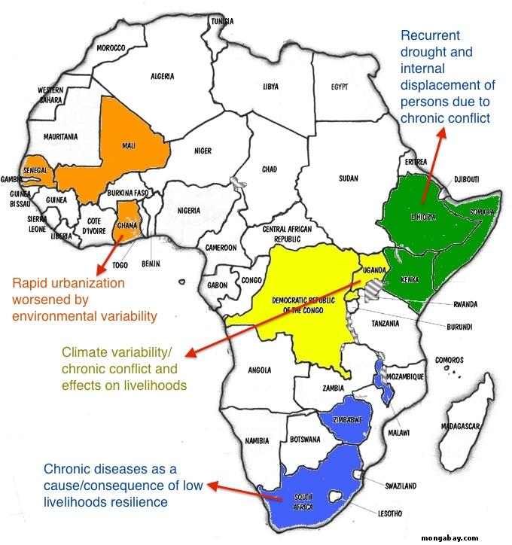
WHAT IS RAN?
Research and Innovation Network initially solely funded by USAID
We are a network within a Network
One of 7 Development Labs under the Higher Education Solutions Network (HESN) based in the Office of Science and Technology (OST), USAID
Has rallied a network of 20 universities across Africa congregated into 4 Resilience Innovation Labs (RI Labs)
Spearheaded by Makerere University with secretariat based at the School of Public Health

Slide 3
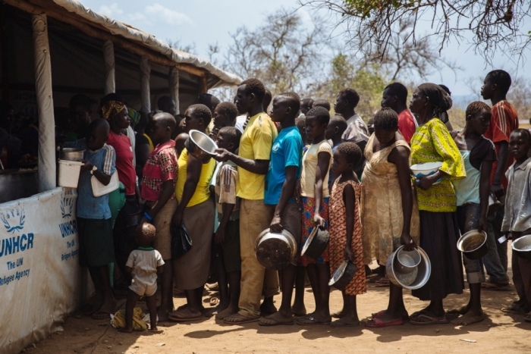
RATIONALE FOR THE NETWORK
Although development efforts have saved lives, they have not sufficiently built resilience of target communities; the same shocks/stresses recur with similar consequences
RAN seeks to break these negative cycles by tapping into the adaptive capacities of communities and the potential of African students, scholars to ideate, develop and implement solutions that build resilience of communities’

Slide 4
WHAT IS INNOVATION?
DESIRABLE
(HUMAN)
FEASIBLE
(TECHNOLOGY)
“A technology or approach that outperforms normative ways of doing things, to drive new behaviours, outcomes, value creation, and system transformation either through modifying an existing idea or developing a completely novel approach (Invention) “
~ Banny Banerjee
VIABLE
(BUSINESS)

Slide 5
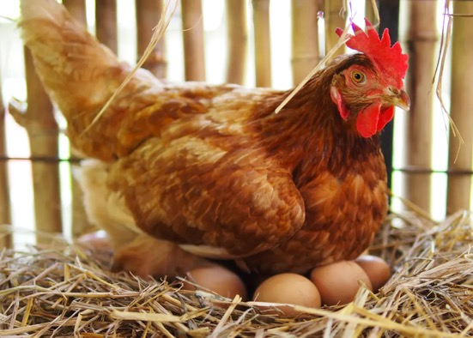
A FEW EXAMPLES FROM RAN…
AN APPROACH
VS
A TECHNOLOGY
Village Egg Bank Project
The PedalTap

Slide 6
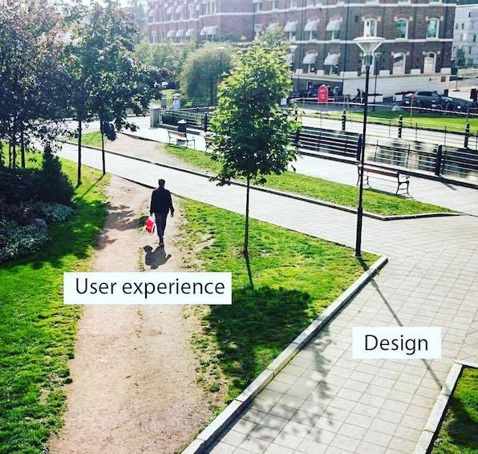
WHAT IS HUMAN CENTERED DESIGN?
It is systematic process that draws upon logic, imagination, intuition, and systemic reasoning, to explore possibilities of what could be—and to create desired outcomes that benefit the end user
Once we’ve determined a range of desirable solutions for the community we’re serving, we hone in on:
What is technically feasible to implement
How to make the solution financially viable. (business model)
DESIRABLE
(HUMAN)
FEASIBLE
(TECHNOLOGY)
VIABLE
(BUSINESS)
HCD Starts here…

Slide 7
OVERVIEW OF THE PROCESS
NEED FINDING
IDEATION
(STRUCT. BRAINSTORM)
TESTING
PROBLEM FRAMING
PROTOTYPING
***KEY THINGS TO NOTE ***
The process CYCLICAL because of constant iteration
It is a process of divergence and convergence
Thrives on the principle of failing FAST and CHEAPLY

Slide 8
LETS GET STARTED…

Slide 9
GROUP EXERCISE (15 MINUTES)
The HCD approach begins with a design challenge…
Form groups of 6-8 people (Multidisciplinary team)
Brainstorm ‘the most pertinent challenges you face as students’ (10 minutes)
Everyone in the group should write their responses on a sticky note without consultation
Cluster your challenges according to themes (5 minutes)
Vote- use the voting stickies to vote (independently) on the challenge you think is most common and most pertinent (5 minutes)
Note down- the design challenge: ‘Our design challenge is to….”

Slide 10
STEP 1. NEED FINDING
CLICK ICON FOR VIDEO
WHAT DO YOU LEARN FROM THIS VIDEO?
Our knowledge makes us vulnerable, biased and causes us to miss out on opportunities

Slide 11
STEP 1. NEED FINDING
This step is the corner stone of the Human Centered Design process.
During this stage, we seek to empathize to understand our users (the community of people we seek to serve)
Critical to the need finding stage is:
Observation: behavior, culture, context
Engagement: ask probing questions, get interested!
Immersion: Put ourselves in the person (user’s) shoes
A multi-disciplinary team to note down different observations and insights
WHAT YOU SEE
WHAT IS ACTUALLY OUT THERE
Source: Prof Banny Bannerjee (Stanford University)

Slide 12
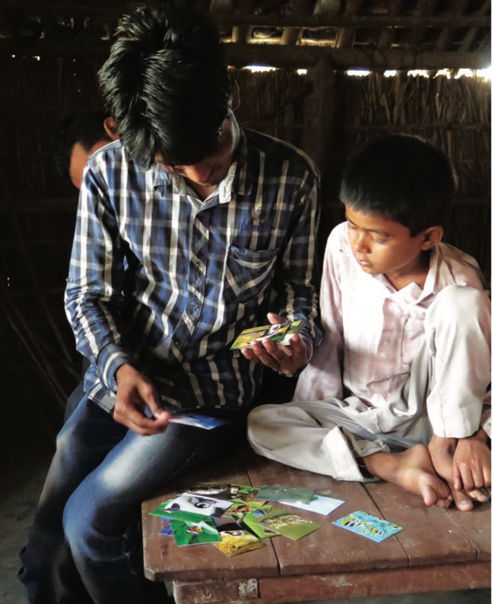
STEP 1. NEED FINDING
METHODS:
Secondary Research (e.g. Literature review)
Interviews (‘Why? Why? Why?’- important to probe
Expert Interviews (aka Key Informant Interviews)
In-depth Interviews
Focus Group Discussions
Ethnographic Studies (immersing yourself in a given context)
It is important that the user/respondent feels comfortable and that the problem is simplified to aid their understanding and responses.
Photo Credit: IDEO.org

Slide 13
GROUP EXERCISE (30 MINUTES)
Design Challenge: ___________________________
Going back to the problem you identified and prioritized
Go round and share some experiences you know of or may have personally experienced relating to the problem area
For every experience shared probe for:
How it happened? (What led to it occurring)
Who it happened to? (The demographic of persons)
Why? Why? Why?
Try to be as specific as possible
Note down your insights on the grid
Who?
Who was affected by the problem?
Age, sex, time of day,…
Why?
Unearth the underlying reasons how and why this challenge manifests
What?
What solutions exist and why do/don’t they work?
Quotes?
Key quotes that stood out

Slide 15
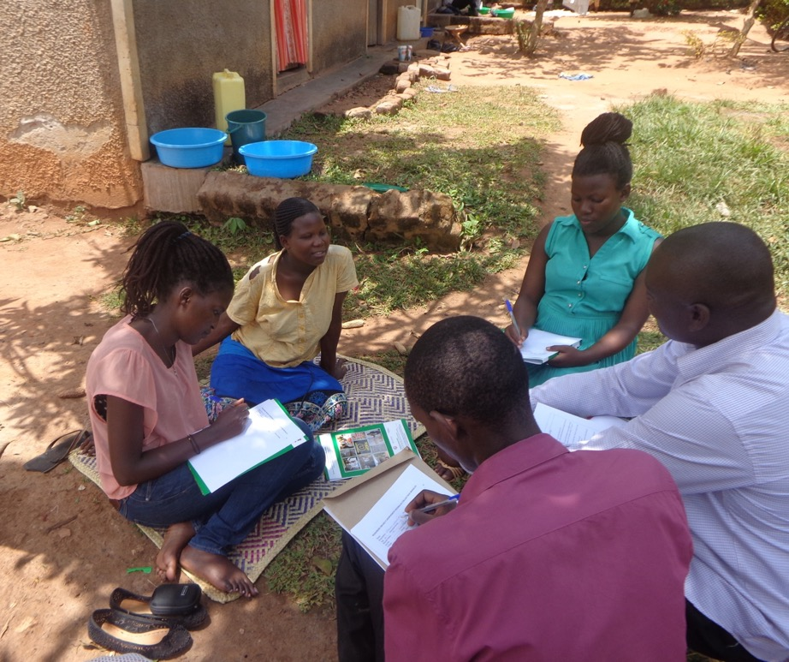
STEP 2. PROBLEM FRAMING
The objective here is to craft these into a meaningful & actionable problem statement
We do this by:
Focusing on what stood out as we spoke and observed the people
Identifying meaningful patterns and relationships
Synthesizing and select the most important and consistently expressed set of NEEDS
Express the insights developed through synthesis

Slide 16
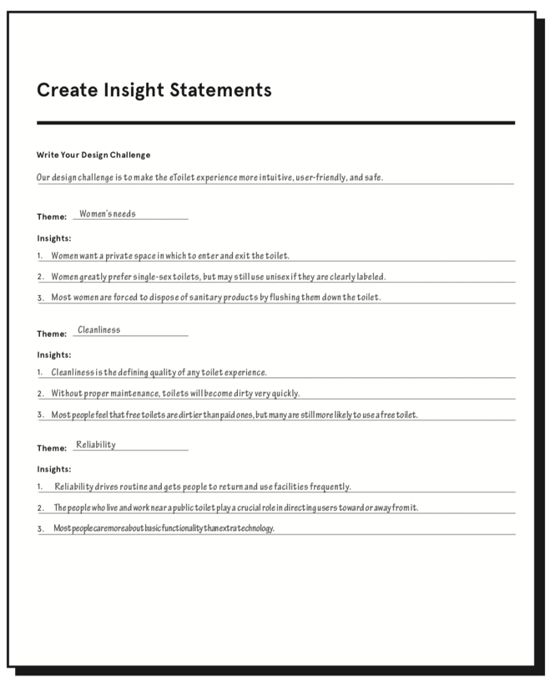
GROUP EXERCISE (30 MINUTES)
Go back to the grid you developed in the last exercise
First (20 minutes)
Cluster the insights shared into themes
Select the top three most important themes
Bullet 3 of the most important key insights shared under each theme
Next (10 minutes)
Turn the insights under each theme into a ‘How might we…?’ statement
Source: IDEO.org

Slide 17
STEP 3. STRUCTURED BRAINSTORMING
We shall focus on generating solutions to address our challenges – its not about coming up with the right idea, its about generating the broadest range of possibilities.
Multi-disciplinary teams are KEY
The rules for structured brainstorming :
Defer judgement
Encourage wild Ideas
Build on the ideas of others
Stay focused on the topic
One conversation at a time
Be visual
Go for quantity
“The best way to get a good idea is to generate lots of ideas.” ~ Linus Pauling, Nobel Prize Chemistry (1954)

Slide 18
STEP 3. STRUCTURED BRAINSTORMING
Headline & cluster
Cluster Similar ideas into groups
Combine cluster that target different facets of the design challenge
Vote
Voting based on what is feasible but also what will have the highest impact
Source: Prof Banny Bannerjee (Stanford University)

Slide 19
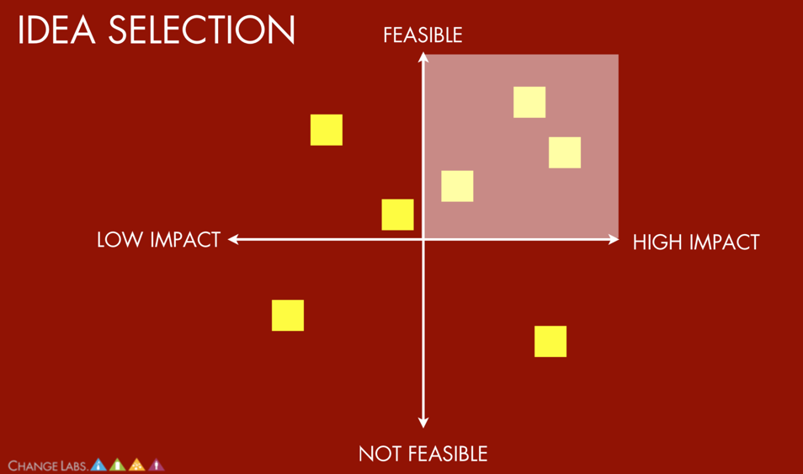
GROUP EXERCISE (70 MINUTES)
Use 30 minutes to brainstorm on as many solutions as possible
Remember the brainstorming rules!
Cluster the ideas proposed into (30 minutes)
similar ideas
ideas that will work well together
Rank and vote (10 minutes)
Place your clusters of ideas along the grid
Vote for one to implement that falls in the domain highlighted (i.e. most feasible and greatest impact)
Source: Prof Banny Bannerjee (Stanford University)

Slide 20
LUNCH BREAK

Slide 21
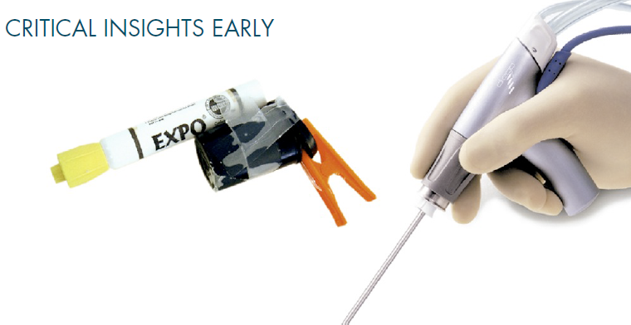
STEP 4. RAPID PROTOTYPING
A Prototype is anything that a user can interact with. It can be a gadget put together, a role playing activity or a storyboard
WHY PROTOTYPE?
To communicate and show how the idea has transformed to a solution
To spot opportunities early
To start a conversation; users express themselves more when they have an object to refer to.
To fail quickly and cheaply
To test as many possibilities as possible
Photo credit: Prof Banny Bannerjee (Stanford University)

Slide 22
STEP 4. RAPID PROTOTYPING
Source: Prof Banny Bannerjee (Stanford University) ‘Fail early and often to succeed sooner’

Slide 23
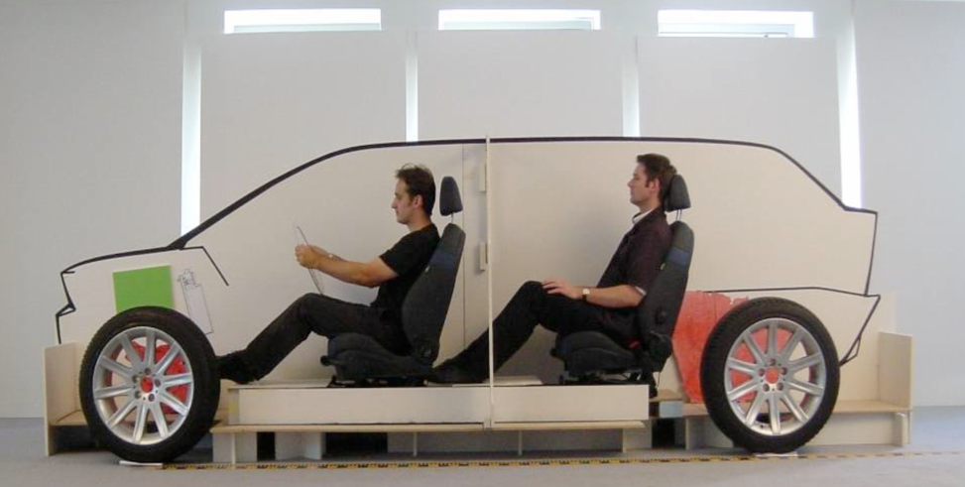
STEP 5. TESTING
Provides an opportunity to learn about your solution, user. and to get feedback about the prototypes to make changes where possible.
How we test
Show, don’t tell (people often say one thing and act in a different way)
Create experiences (try to get as many of the users’ senses involved)
Encourage comparison
Photo credit: Prof Banny Bannerjee (Stanford University)

Slide 24
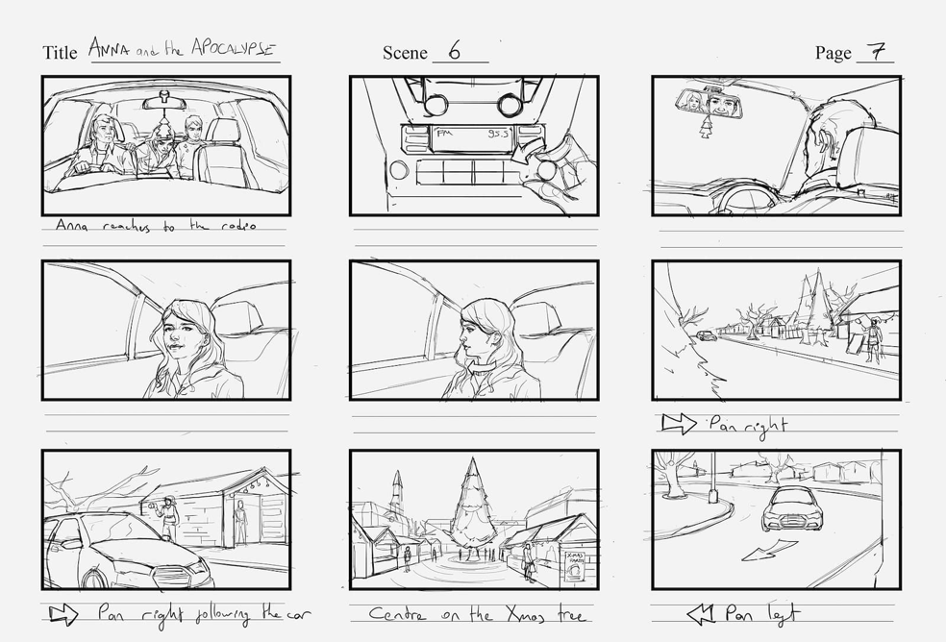
GROUP EXERCISE (… MINUTES)
Use the materials provided to build a prototype of your solution. The prototype can be:
A story board
A 3D model of the gadget
An application wire frame
A role play
Be as visual and detail oriented as possible. It has to be something tangible that conveys the idea you want to test

Slide 26
WHAT NEXT?
ITERATION: Integrating user-feedback into your design
VIABILIY: Thinking about how this solution will generate an income (business model canvas)
ROAD MAP: Setting a road map to implementation
PARTNERSHIPS: Who do we need to partner with and at what stage?
RESOURCES: What are your immediate, medium-term and long-term resource needs and how will they be met?
DESIRABLE
(HUMAN)
FEASIBLE
(TECHNOLOGY)
VIABLE
(BUSINESS)

Slide 27
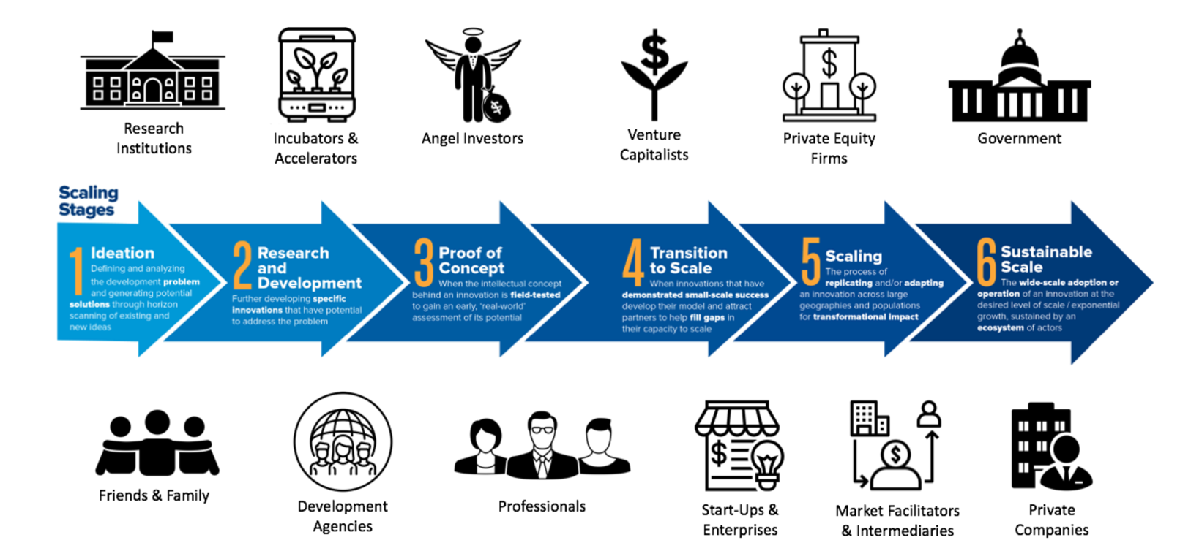
THE INNOVATION PIPELINE
Source: IDIA 2019- The Innovation Pipeline and strategic partnerships

Slide 28
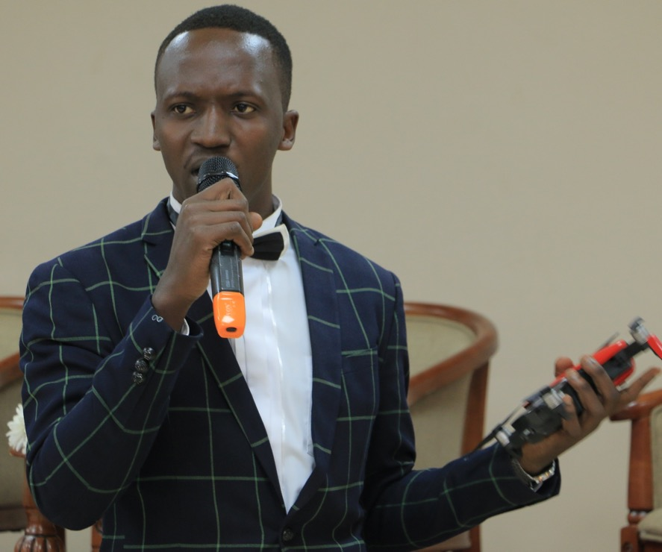
PITCH- STORY TELLING
The best pitches evoke the emotions of their audience.
Things you could include in your pitch:
Build a narrative
Tell a brief and engaging story, focusing on the most important aspects of your concept.
Create a provocative statement for your idea. “What if...?” “Imagine a world where…”
Communicate your value
Share concisely the value you hope to offer through the concept
Who is it targeting and what are their most pertinent needs
Demonstrate

Slide 29
GROUP EXERCISE (60 MINUTES)
In your groups prepare your own pitch. The pitch should be 5 minutes long Include:
Problem statement
Value Preposition
Demonstration of solution
Team & expertise

Slide 30
PITCHES & FEEDBACK

