Slide 1
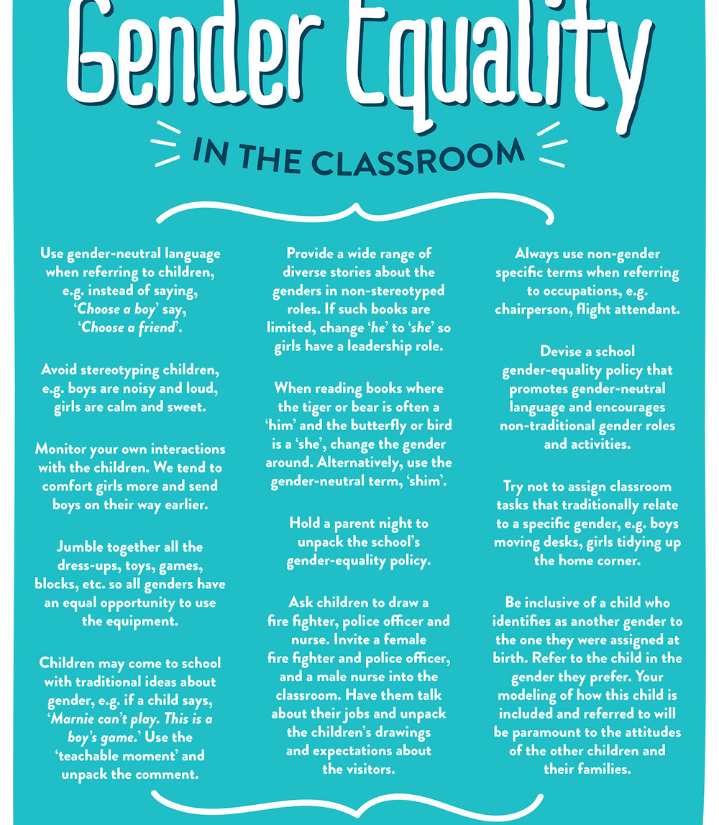
Delivering practical, research-driven solutions to global development challenges
Gender Analysis in Research and Application
A Differential Focus in Planning Translational Research for Development
Notes:
My name is Andrea Burniske. I am the Program Director for LASER PULSE, a …….

Slide 2
Learning Objectives for Applying Gender Considerations in Research and in Practice
At the end of the training, researchers and practitioners should:
Be able to articulate the difference between gender and sex
Be able to explain the different levels of gender approaches, from gender-exploitative to gender-transformative (quiz around which one of the following is gender-approaches
Provide examples of interventions that were problematic because they did not address gender
Identify research that is flawed because it does not address gender considerations
Identify at least three domains (4 presented here) or considerations (5 are presented here) for conducting a gender analysis
Identify the three main types of gender bias in research
http://genderstandards.org/

Slide 3
Gender does not mean ‘women’
Gender is not the biological sex of a person: it is a concept. It refers to the way different societies attribute qualities (identity) -such as character, skills, abilities, responsibilities and expectations (roles) and entitlements (rights, and opportunities), etc. to a person based on their biological sex. This is so deeply ingrained that we do not notice it.
We start learning gender roles from the time we are born, based on the way our family and others treat us, and their expectations of us. (socialization)
Notes:
Gender is a concept that intersects all demographic considerations, including age, ethnicity, religion, class

Slide 4
Why is it important to analyze how gender considerations impact males and females differently?
Gender has human rights implications: If we believe gender stereotypes, we accept that certain conditions and situations that violate human rights are acceptable.
Gender has development implications: The way we view gendered roles can have negative generational impacts, such as excluding certain categories of people, replicating cycles of poverty.
Notes:
First point:
In certain cultures this means that girls are not allowed to go to school, and in such cultures they may be married very early.
Men and boys are seen as legitimate conflict actors. This means that they are most likely recruited and/or targeted for conflict situations.
Second Point:
In many cultures this means that boys grow up with the idea that ‘real’ men do not take care of children, and that children are solely the responsibility of women.
How might that impact children’s psychological development? What impacts for food security, health, education, and other sectors might the absence of a father have?
How might the idea that only women are responsible for children, in a country that does not value women, play out in terms of funding and planning prioritization for women and children’s issues?

Slide 5
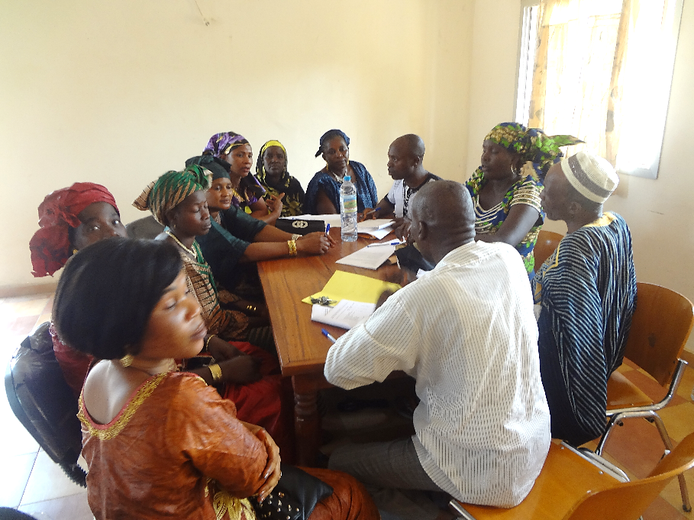
A Gender Analysis is a systematic approach, usually using social science methodologies, for examining problems, situations, projects, programs, and policies to identify the gender issues and impacts.
One must always ask how a particular activity, decision, or plan will affect men differently from women in areas such as access and value of labor, property access and ownership, access to information and services, participation and social status.
Notes:
Look at this statement: “In a motion calling for a special fund to tackle the problem, MP Anthony Oluoch said “overall unemployment among youth is at 55%”.
https://africacheck.org/2018/10/08/analysis-how-many-young-kenyans-are-unemployed-a-look-at-the-numbers/
But who is unemployed? “…unemployment, underemployment and inactivity of females is estimated to be double that than of males (KEPSA n.d.). This suggests that although there have been factors encouraging female access to education, young females are still far less prepared for the labour market than males –or less prepared for sectors with higher employment rates (such as construction). Several explanations have been proposed for this:•Some researchers theorise that this may be because of the types of skills taught in female dominated subjects differ to those taught in male dominated areas. Murgor (2013) suggests that women have lower skills in science and technology areas, which are in high labour demand. He also found that numeracy, leadership, and self-confidence are less likely to be fostered in female dominated subjects, and that curricula are perpetuating traditional stereotypes rather than meaningfully challenging them (Murgor 2013). •Another suggestion is that females drop out of further education and training at a higher rate than males, due to factors such as pressure to get married, discrimination by teachers, and family preference to educate male children first (AfDB 2015). •At the university level, Gitonga (2014) found that males and females tend to seek work in different sectors, and follow different strategies for seeking employment. It was discovered that male graduates preferred to work in the for-profit sector, and that they marketed their skills directly to companies, whereas females preferred to work in the non-profit sector, and relied on their social networks to secure employment opportunities (Gitonga 2014). This data is limited to a very small sample, however, and there is room for more in-depth studies on university graduates. Despite the marked difference in female and male employment rates, it is widely recognised that female involvement in the labour market is fundamental to Kenya’s economic growth. - https://www.britishcouncil.co.ke/sites/default/files/ng_kenya_youth_employment_in_kenya.pdf
If we do not understand the different contexts of males and females, and why young women are more unemployed, we cannot intervene effectively.

Slide 6
Here are four key considerations for conceptualizing and using a gender lens to think critically and to strategically frame your research, as well as its translation to practice
Notes:
Here are some other domains that can reveal the inequalities / gaps that exist:
Cultural norms, roles, and responsibilities
Laws, policies, and institutional practices

Slide 7
Gender Analysis Research Quick Check
Have you done a literature review on the gender considerations for your research sector, topic, subjects?
Will you collect age and sex-disaggregated data in both the research as well as the translation of the research?
How do prevailing gender norms serve as barriers or enablers to the access, use, and uptake of policies, practices, or products that will result from your research?

Slide 8
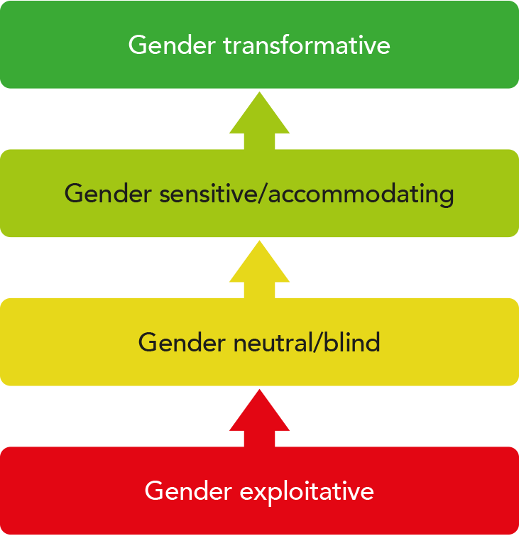
Gender Blind Example
If we don’t address gender, we are being gender neutral, or ‘gender blind.’
“Demobilization programs for ex-combatants … defined a combatant as anyone who carried a gun in combat. Thousands of women who had been kidnapped or coerced into the armed forces and served as cooks, bearers, messengers and even sex slaves were largely excluded. Further, camps for demobilized soldiers and even for displaced persons were rarely constructed with women in mind, such that women risked rape or death each time they left the camp to collect firewood or used latrines in isolated and dimly-lit settings.”
“Male ex-combatants received demobilization assistance, but were sent back without skills or education to communities that had learned to live without them during decades of conflict. The frustration of these men exploded into an epidemic of alcoholism, drug abuse, rape and domestic violence.”
https://www.crisisgroup.org/global/beyond-words-and-resolutions-agenda-unscr-1325
Notes:
Narrative: In being gender neutral, we are acting as if gender does not exist, and concepts of gender do not impact our research focus, assumptions, findings, and applications. ‘Blindness’ refers to the inability to see. Not seeing the results of gender bias or discrimination doesn’t mean it is not there.

Slide 9
Gender-Exploitative Example.
Gender Exploitative means that we use existing (often harmful, unjust) stereotypes to build our program intervention or communications campaign. There is sometimes a fine line between exploitation and accommodation.
A campaign that tries to prevent gender-based violence by using a tagline “Real men don’t beat women, they protect them” has good intentions. But it draws heavily on traditional stereotypes that position women as weaker, and in need of protection, and men as dominant, in a role of protector or abuser. And the use of the ‘real men’ qualifier is problematic.
A program that enlists the assistance of female health workers because this work is considered acceptable for women is a gender-accommodating (recognizing women’s traditional roles and acting according to those). Likewise, projects that provide training for women to sew clothing, or to style hair in order to generate increased income.

Slide 10
Applied Gender Analysis
Notes:
Some disciplines can appear to be less amenable to gender analysis than others. Sectors that rely on hard sciences, typically perceived as ‘masculine sectors,’ can be especially challenging to apply a gendered lens. The next several slides provide some examples of where this has been done to yield fruitful applied research results.

Slide 11
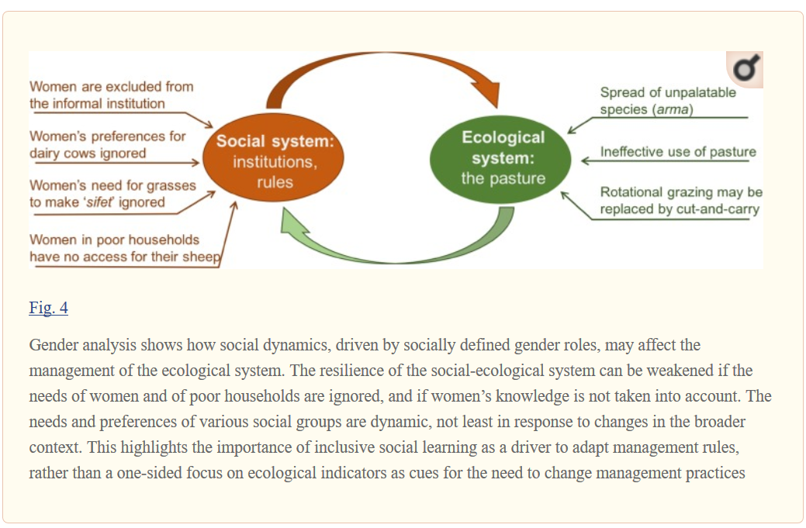
Case Study of Impacts of Gender Bias in Practice
Food Security: Data were collected using qualitative methods, including focus group discussions, in-depth interviews, and participant observations from one community in the highlands of Ethiopia.
The failure to take into account gendered roles in the management of a communal pasture had impacts on the resilience of the social-ecological system.

Slide 12
A Gender Lens to Research on the Energy Sector
But energy has different implications for men and women no matter where you focus.
Alternative business models can help lower the cost of many energy access technologies to extend the reach of electricity. A suggested research focus area is on micro-grid models: Is a community-owned and operated or a single entrepreneur-owned and operated model more appropriate, given a community’s geography, culture, access to technology, and finances. Are entrepreneur-owned and operated models likely to create new power monopolies and dynamics in regions where society already struggles with entrenched power disparities?
In applying a gender lens to management of micro-grids, we can ask how many electricity entrepreneurs are women? What is the rate of success in managing off-grid energy distribution systems or sales by women versus men, and why?
Notes:
It is challenging for researchers and implementers alike to apply a gendered lens to sectors that most people consider gender-neutral, such as energy.
If we want to look at access issues, we know that gender is an important consideration in an energy access perspective as research has shown the disproportionate impact on women’s health and productivity, resulting from the lack of adequate energy access
https://www.csis.org/analysis/down-last-mile-key-research-needs-energy-access

Slide 13
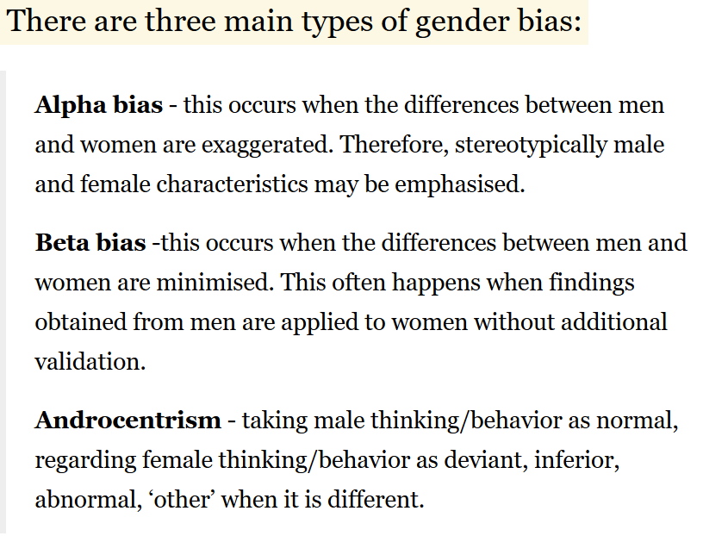
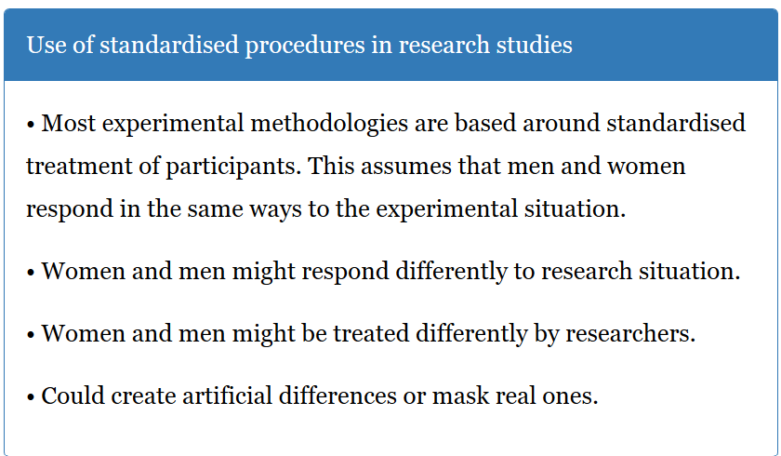
Gender Bias in Research
https://www.simplypsychology.org/a-level-debates.html
Notes:
Narrator: Examples of Gender Bias in Research
Psychology: Kohlberg & Moral Development. Kohlberg based his stages of moral development around male moral reasoning and had an all-male sample. He then inappropriately generalized his findings to women (beta bias) and also claimed women generally reached lower level of moral development (androcentrism).
Medicine: The evidence basis of medicine may be fundamentally flawed because there is an ongoing failure of research tools to include sex differences in study design and analysis. The reporting bias which this methodology maintains creates a situation where guidelines based on the study of one sex may be generalized and applied to both.
https://www.ncbi.nlm.nih.gov/pmc/articles/PMC1761670/
The lack of incorporation of gender data into evidence-based medicine. Despite well recognized gender differences in coronary heart disease management in UK critical care units,¹³ the UK NHS guidelines for management are not gender specific.¹⁴ If research lacks or excludes female subjects then the guidelines should clearly state that the evidence has been obtained mainly from men. In addition, the context in which the evidence basis for medicine is drawn is also questionable because the factors that contribute to women's health (or lack of it) such as poverty and social deprivation will not be the same as for men. These differences need to be defined in order for guidance to reflect the social context of disease. Furthermore, the outputs of biased guidance can influence education, both in terms of what is taught (i.e. maintenance of the status quo) and who teaches it (e.g. gender bias in training) so that inequality is perpetuated.

Slide 14
Gender Bias in Research Methods
Scientific knowledge itself is often held up as being hard, factual, objective, rational, impartial and unaffected by human emotion – all attributed to masculine qualities. Science based on more perceptual and subjective, emotionally driven and influenced by humans – qualities typically associated with femininity.
Gender bias affects which research is published, cited and used as evidence for policies and other interventions.
There are also gender biases in terms of whose knowledge is considered credible.
Notes:
Narrator
Methods and findings are often judged against these criteria. Contrasts are often drawn between ‘hard’ life and natural sciences and the ‘soft’ social sciences. Guess which branches receive more funding?
Because ‘hard’ sciences are considered by many to be more credible than ‘soft’ scientific research, there is greater demand by funders of research for quantitative data gathered through methodological approaches such as randomized control trials (RCTs) and a lesser interest in research generated by qualitative methods.
Male, Western dominance in the field of science has been reinforced by the idea that (usually white) men from Western institutions are the scientific experts. This means that local knowledge, particularly women’s knowledge, is often discounted as ‘anecdotal’ or simply ignored. However this knowledge is just as valid as ‘objective’ data, and is vital to factor into research if it is to be of real benefit.

Slide 15
Gender mainstreaming is relevant for all areas of science to:
Enable more inclusive, representative scientific research that reflects the different needs of women and men,
Enable more effective, targeted solutions for women and men
Avoid gender stereotypes and promote gender equality
Challenge scientific knowledge and assumptions
Produce innovative research and better results
https://scidevnet.teachable.com/courses/110589/lectures/1631244
Notes:
Narrator
Scientific research is often assumed to be gender neutral – representing the views and experiences of males and female researchers and research subjects. However it is in fact gender blind, hiding an androcentric focus where male bias informs what is produced, whose knowledge and experience is considered relevant, and who has participated in creating the knowledge. Many have argued that the entire field of knowledge on life and natural sciences is influenced and skewed by particular gender ideas and stereotypes.

